Slide 1



Search
B877005 Kim Wanil B877022 Yang Yeeun

Slide 2
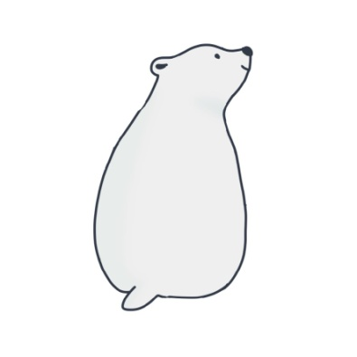



The polar bear, who lost his place to live due to the warmer weather, crosses the glacier and leaves for a new place to live.

Slide 3






It's a game of polar bears crossing glaciers that move from side to side.
Polar bears get a coin when they jump over on which the fish are placed.
If you don't land properly on the ice or land on , the game will end.

Slide 4
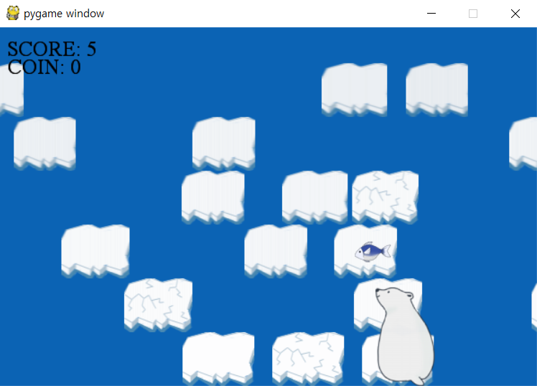
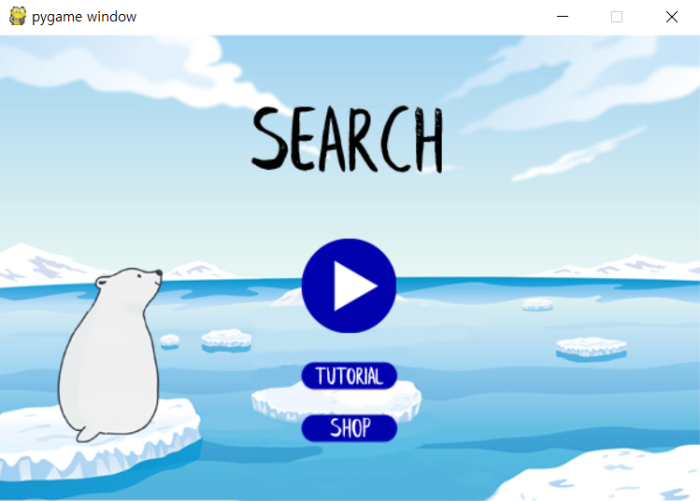

Start screen Play screen

Slide 5

Thank you!

